Slide 1


          University of Diyala
          College of Engineering
          Department of Electronics Engineering
Course Number: U103
Course Name: Computer Networks
Lecture (4)
Asst. Lect. Ahmed Mohammed Ahmed

Slide 2
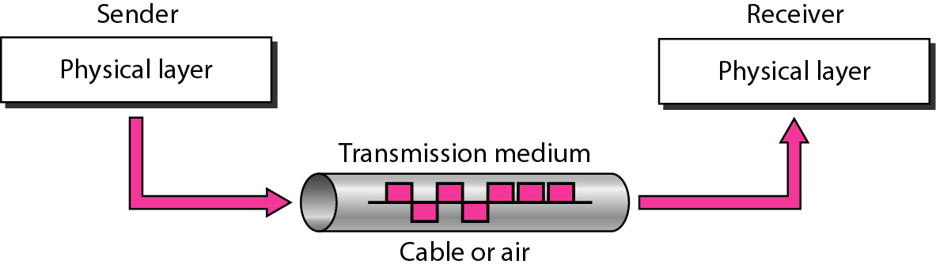
Transmission Media
Introduction
Transmission media are actually located below the physical layer and are directly controlled by the physical layer. Figure 4.1 shows the position of transmission media in relation to the physical layer.

Slide 3
The transmission medium is usually free space, metallic cable, or fiber-optic cable. The information is usually a signal that is the result of a conversion of data from another form.
Computers and other telecommunication devices use signals to represent data. These signals are transmitted from one device to another in the form of electromagnetic energy, which is propagated through transmission media.
In telecommunications, transmission media can be divided into two broad categories: guided and unguided. Guided media include twisted-pair cable, coaxial cable, and fiber-optic cable. Unguided medium is free space. Figure 4.2 shows this taxonomy.

Slide 4
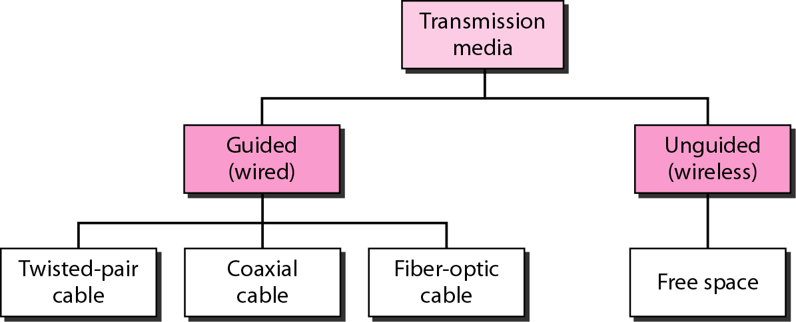

Slide 5
GUIDED MEDIA
Which are those that provide a conduit from one device to another, include coaxial cable, twisted-pair cable, and fiber-optic cable. Twisted-pair and coaxial cable use metallic (copper) conductors that accept and transport signals in the form of electric current. Optical fiber is a cable that accepts and transports signals in the form of light.
Coaxial Cable: - Coaxial cable (or coax) carries signals of higher frequency ranges than those in twisted pair cable, in part because the two media are constructed quite differently. coax, has a single, coated copper wire center and an outer metal mesh that acts as both a grounding circuit and an electromagnetic shield to reduce interference. The outer layer is the plastic cable jacket, figure (4,3).

Slide 6
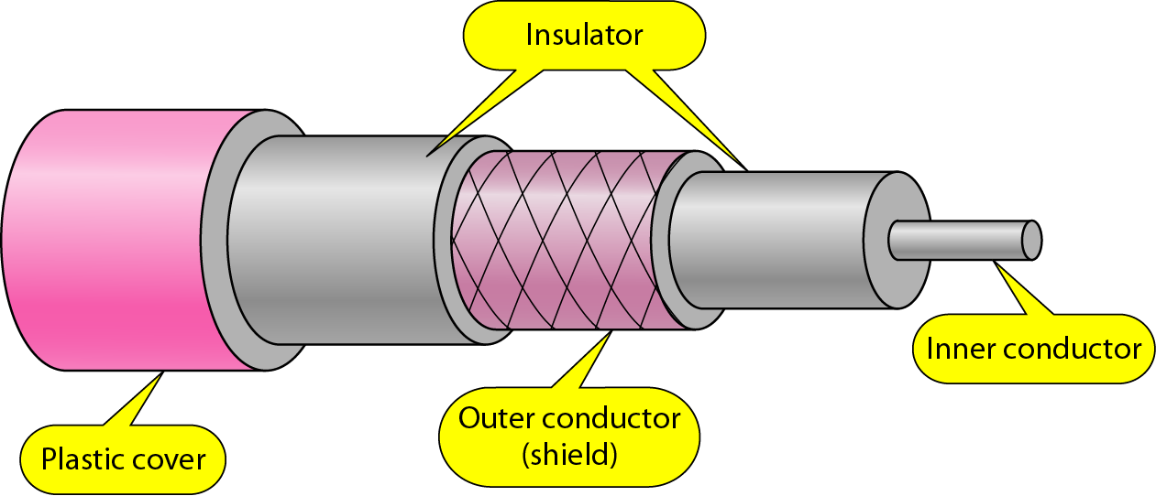

Slide 7
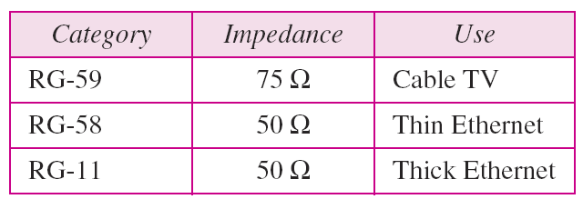

Slide 8
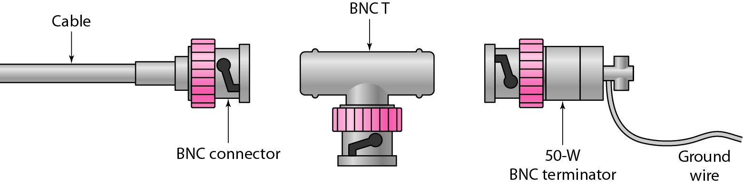

Slide 9
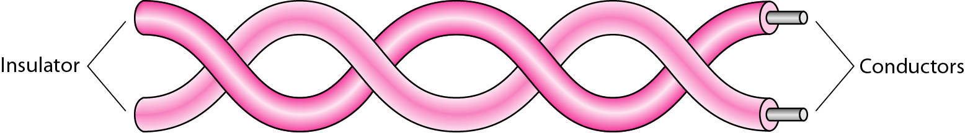
Twisted-Pair Cable: - A twisted pair consists of two conductors (normally copper), each with its own plastic insulation, twisted together, as shown in Figure 4.5.

Slide 11
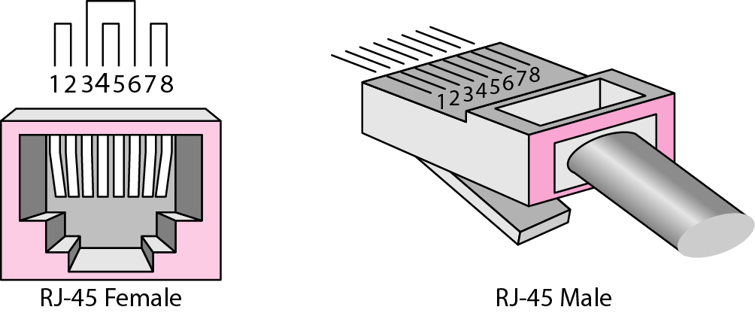

Slide 12
Fiber-Optic Cable: - At the physical layer, diverse technologies can perform the same function of data transfer. Fiber-optic cable is very different from copper, yet both effectively carry data over networks. Whereas copper uses electrical voltage to represent data on the wire, fiber-optic cable uses light pulses conducted through special glass conductors to carry data. The cable is engineered to be as pure as possible and to allow reliable light signals to traverse the medium.
Light travels in a straight line as long as it is moving through a single uniform substance. If a ray of light traveling through one substance suddenly enters another substance (of a different density), the ray changes direction. Figure (4.8) shows how a ray of light changes direction when going from a dense to a less dense substance.

Slide 13
